Slide 1
The GNU Manifesto
Ricardo Bazaldua
Ernesto Garibay
Christian Ortega
Felix Godoy

Slide 2
The GNU Manifesto
The Gnu MAnifesto was written by Richard Stallman in 1985 to ask for support in developing the GNU operating system.
The GNU Project is part of the Free Software Movement, a campaign for freedom for users of software. It is a mistake to associate GNU with the term “open source”—that term was coined in 1998 by people who disagree with the Free Software Movement's ethical values. They use it to promote an amoral approach to the same field.
What's GNU? Gnu's Not Unix!
GNU, which stands for Gnu's Not Unix, is the name for the complete Unix-compatible software system which I am writing so that I can give it away free to everyone who can use it.
GNU will be able to run Unix programs, but will not be identical to Unix. We will make all improvements that are convenient, based on our experience with other operating systems.

Slide 3
Why I Must Write GNU
I consider that the Golden Rule requires that if I like a program I must share it with other people who like it. Software sellers want to divide users and I refuse to break solidarity with other users in this way.
Why GNU Will Be Compatible with Unix
Unix is not my ideal system, but it is not too bad, and a system compatible with Unix would be convenient for many other people to adopt.
How GNU Will Be Available
GNU is not in the public domain. Everyone will be permitted to modify and redistribute GNU, but no distributor will be allowed to restrict its further redistribution.

Slide 4


GNU Contributions tasks
Equipment ease of use and maintain
Programmers who were eager to contribute with distributed work, making replacements fo Unix utilities for compatibility in GNU.
Donations for hire excited programmers that want to make a community (GNU’s objectives)

Slide 5
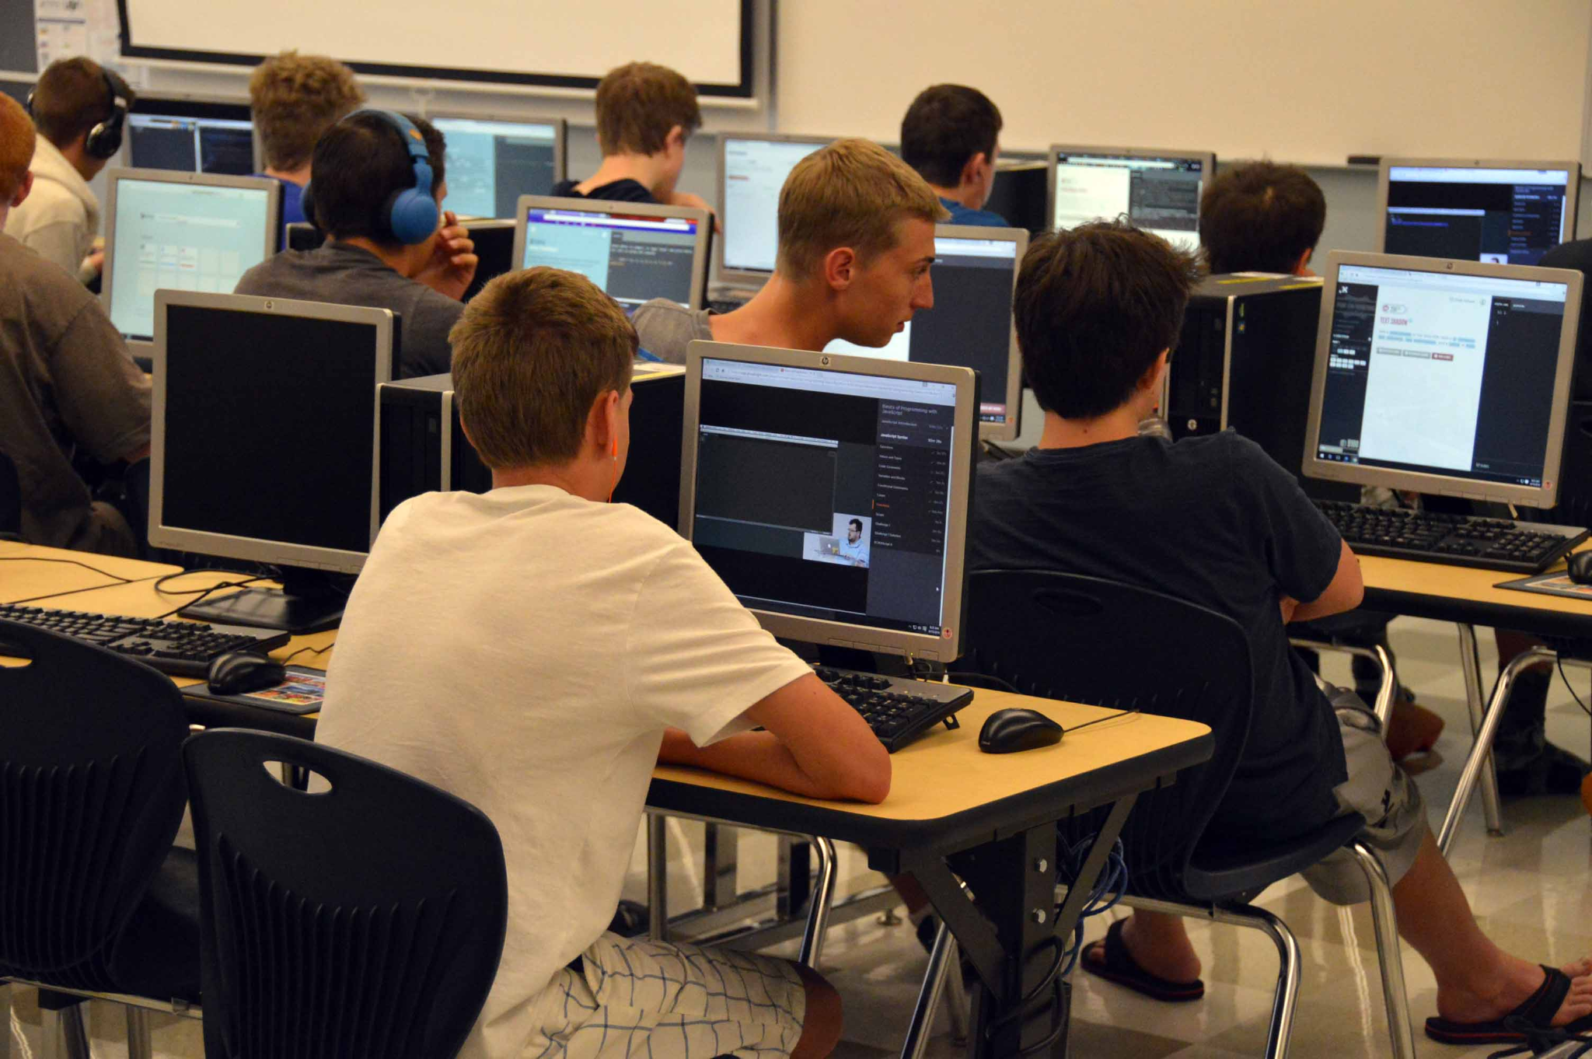
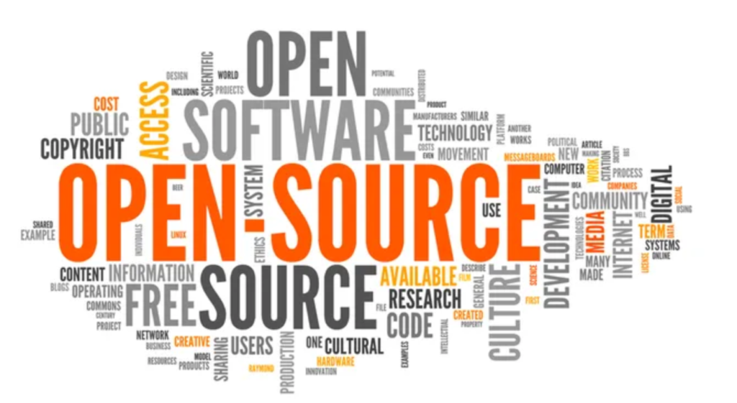

Why GNU will bring us benefits?
Free software / minimum charge. Avoid duplication of system programming, programmers now will be focused to improvements to the OS.
Sources available to everyone, this means that it will open the market and get rid of companies.
Schools will be able to train the students to understand and improve the code.
Collaborations between programmers is natural and productive an it has to be free.

Slide 6
Rebutted objections to GNU’s goals
“You have to charge for the program to pay for providing the support.”
-If it is true that users would rather spend money and get a product with service, they will also be willing to buy the service having got the product free.
“My company needs a proprietary operating system to get a competitive edge.”
-If your business is selling an operating system, you will not like GNU. but If your business is something else, GNU can save you from being pushed into the expensive business of selling operating systems.
“Won't programmers starve?”
- It will still be possible for them to get paid for programming; just not paid as much as now.

Slide 7
.
“Don't people have a right to control how their creativity is used?”
-“Control over the use of one's ideas” really constitutes control over other people's lives; and it is usually used to make their lives more difficult.
“Competition makes things get done better.”
-The paradigm of competition is a race: by rewarding the winner, we encourage everyone to run faster. When capitalism really works this way, it does a good job; but its defenders are wrong in assuming it always works this way. If the runners forget why the reward is offered and become intent on winning, no matter how, they may find other strategies—such as, attacking other runners. If the runners get into a fist fight, they will all finish late.
“Won't everyone stop programming without a monetary incentive?”
-people will program for reasons other than riches; but if given a chance to make a lot of money as well, they will come to expect and demand it. Low-paying organizations do poorly in competition with high-paying ones, but they do not have to do badly if the high-paying ones are banned.

Slide 8
.
“It's no use advertising a program people can get free.”
With advertising, you can reach more users
If many people get GNU from their friends, advertising isn't necessary
“Don't programmers deserve a reward for their creativity?”
Social contribution is a reward if society is free to use the results
“Shouldn't a programmer be able to ask for a reward for his creativity?”
There is nothing wrong with wanting to pay for work, as long as one does not restrict their use.
The desire to be rewarded doesn't justify the restriction of the use of a program.
“Programmers need to make a living somehow.”
Plenty of ways to make money
Handholding and maintenance services.
Distribute free programs and ask for donations.
Development can be funded with a Software Tax
We have already reduced the amount of work that the whole society must do for its actual productivity, but free software could help us to gain more, witch means less work for us.

